Slide 1
CSC371-Database Systems I Lecture-6 (Lab) (Fall 2023)

Slide 2
Previous Lecture Review
SQL Constraints
CHECK
INDEX
FOREIGN KEY

Slide 3
Create table
CREATE TABLE Branch (
branchNo varchar(10) NOT NULL PRIMARY KEY,
street varchar(50),
city varchar(50),
postcode varchar(20),
);

Slide 4
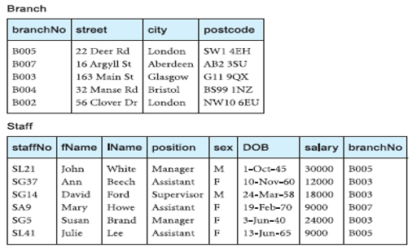
Tables

Slide 5
Agenda
Data Insertion
Data Retrieval from single table

Slide 6
The SQL INSERT INTO Statement
Syntax
INSERT INTO table_name (column1, column2, column3, ...) VALUES (value1, value2, value3, ...);
Insert into Branch (branchNo,street,city,postcode)
Values(‘B005’,’22 Deer Rd’,’London’,’SW1 4EH’)
branchNo street city postCode
B005 22 Deer Rd London SW1 4EH

Slide 7

Insert in different column order
Insert into Branch (street,branchNo,city,postcode)
Values('London','22 Deer Rd','B005','SW1 4EH')

Slide 8
Insert with NULL
Insert into Branch (street,branchNo,city,postcode)
Values(‘B008’,’22 Deer Rd’,’London’)

Slide 9

Insert into Branch1
Values('B008','22 Deer Rd','London',NULL)

Slide 10

Insert into Branch1 (branchNo,street,city)
Values('B010','22 Deer Rd','London')
You can not skip or feed NULL to Primary key attribute or to any attribute with NOT NULL Constraint

Slide 11
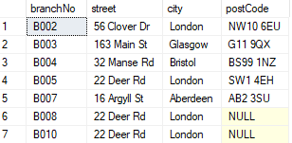
Insert more than one record
Insert into Branch1 (branchNo,street,city,postcode)
Values('B002','56 Clover Dr','London','NW10 6EU'),
('B003','163 Main St','Glasgow','G11 9QX'),
('B004','32 Manse Rd','Bristol','BS99 1NZ'),
('B007','16 Argyll St','Aberdeen','AB2 3SU');

Slide 12
Data Retrieval
Simple statement to retrieve data from table with all attribute and all records
Select * from table_name
Select * from branch
Select branchNo,street,city,postcode from branch

Slide 13
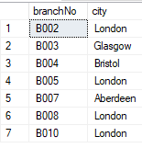
Retrieve Data with specific attributes
Select branchNo,city from branch

Slide 14
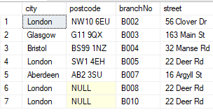
Retrieve Data with different order of attributes
Select city,postcode,branchNo,street from branch

Slide 15
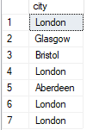
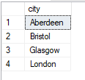
Can we retrieve city names where our organization have branches?
Select city from branch Select distinct city from branch

Slide 16

Can we see the branches in London city?
Select * from branch
where city=‘London’

Slide 17
Summary
Data Insertion
Data Retrieval from single table

